Slide 1
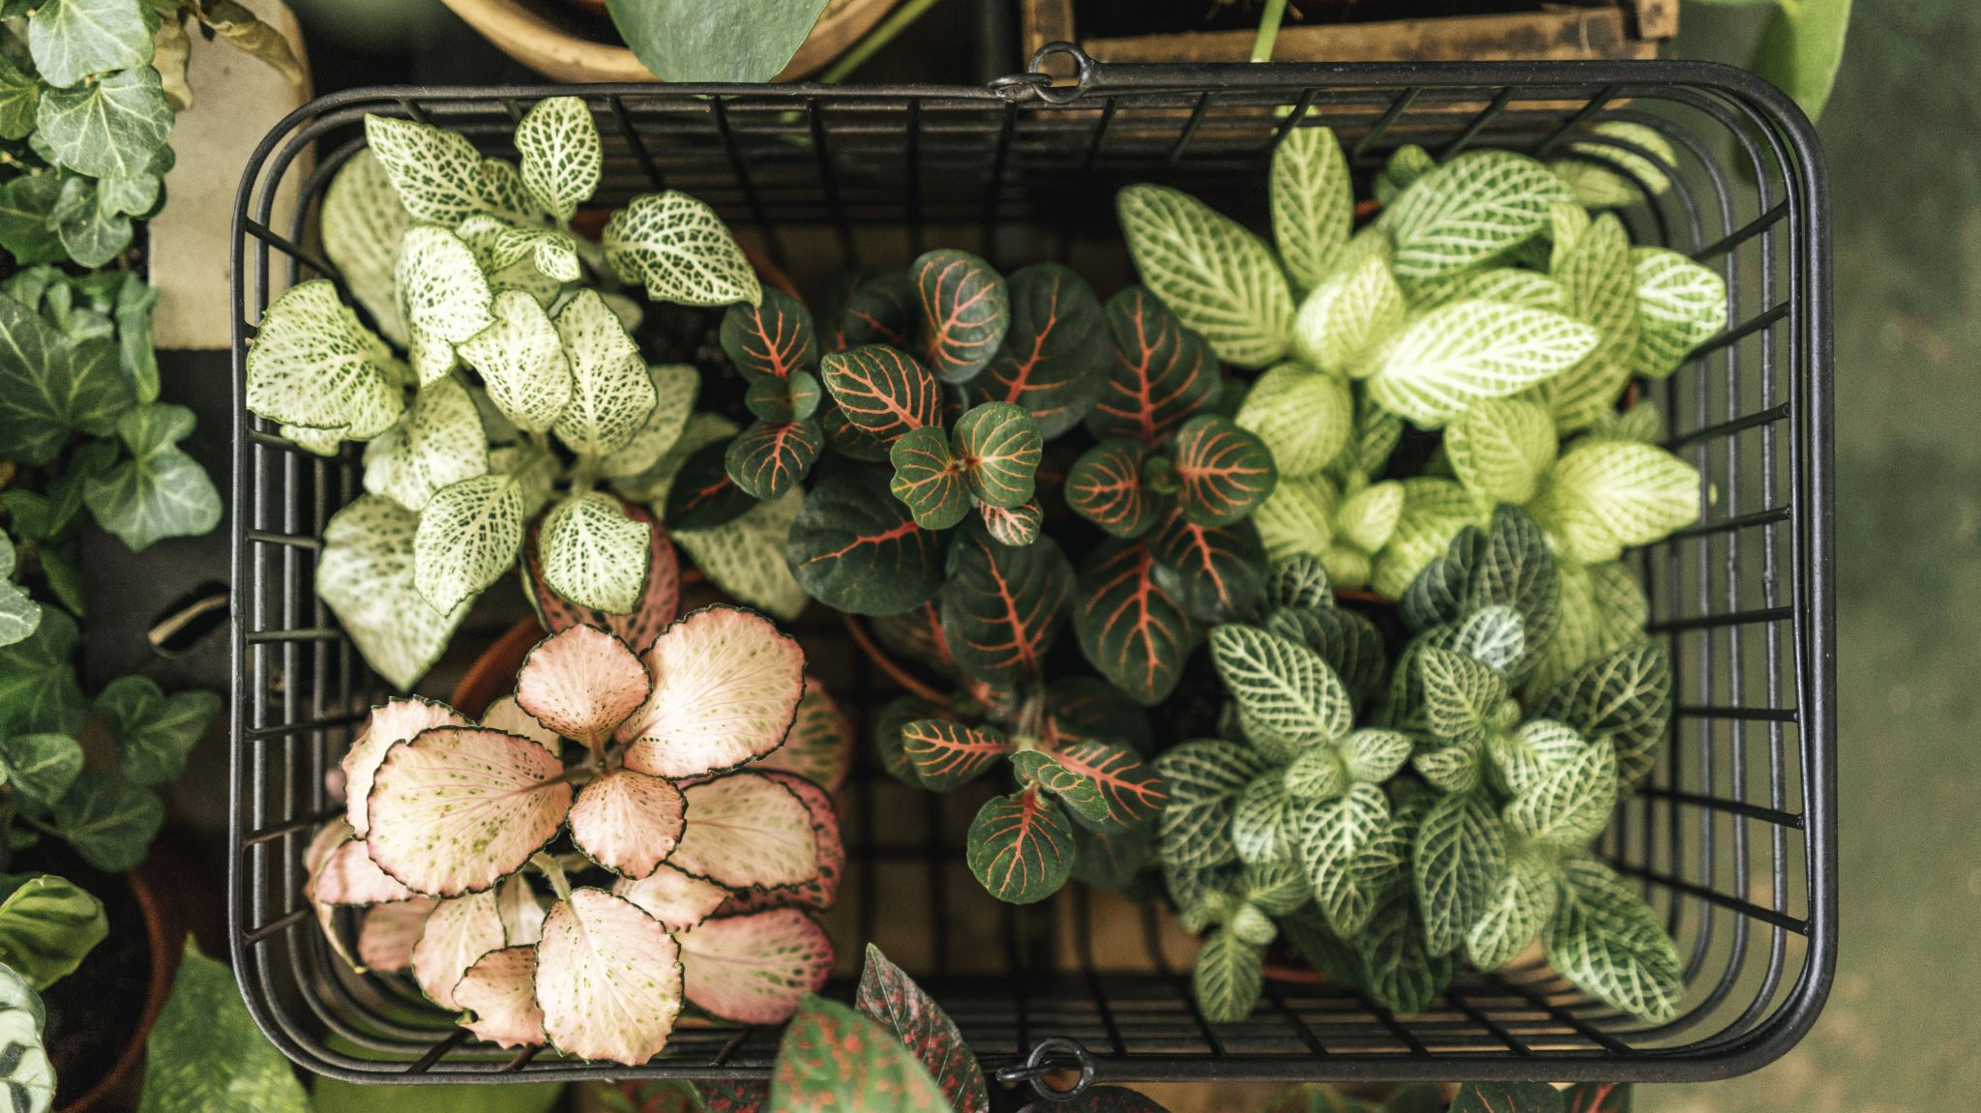
Recreating native weather for indoor plants
Anusha Hegde

Slide 2
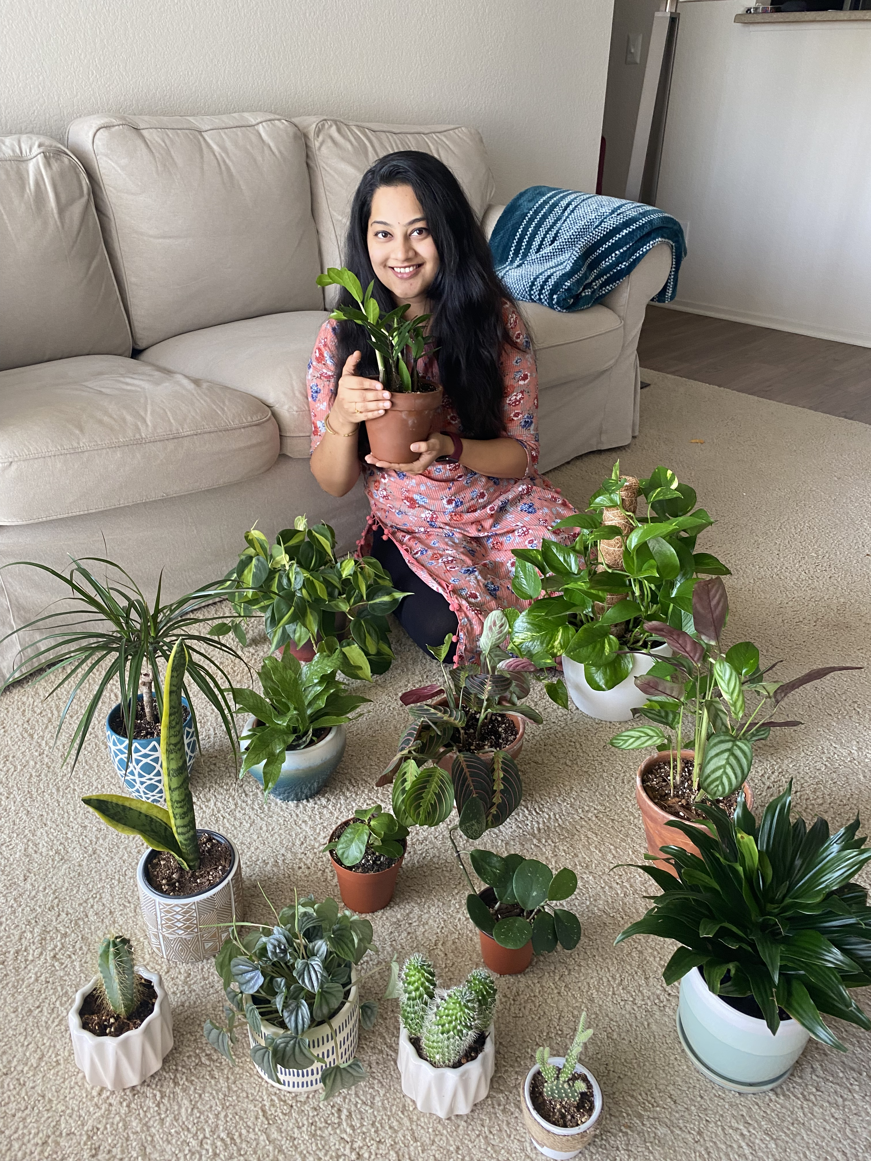
The Motivation was
Wanted to give native weather for my plants
Was looking for ways to look after my plants when I am away

Slide 3
The Goals were
To create weather of any given city in the world as closely as possible including
Humidity
Temperature
Sunrise and sunset
Watering

Slide 4
The system can
Takes any location/city as input and gathers weather details from openweathermap.org
Track sunrise and sunset time and control full wavelength light accordingly.
Get destination location’s humidity and adjust room humidity.
Soil moisture detection.
Watering when soil is dry.

Slide 5
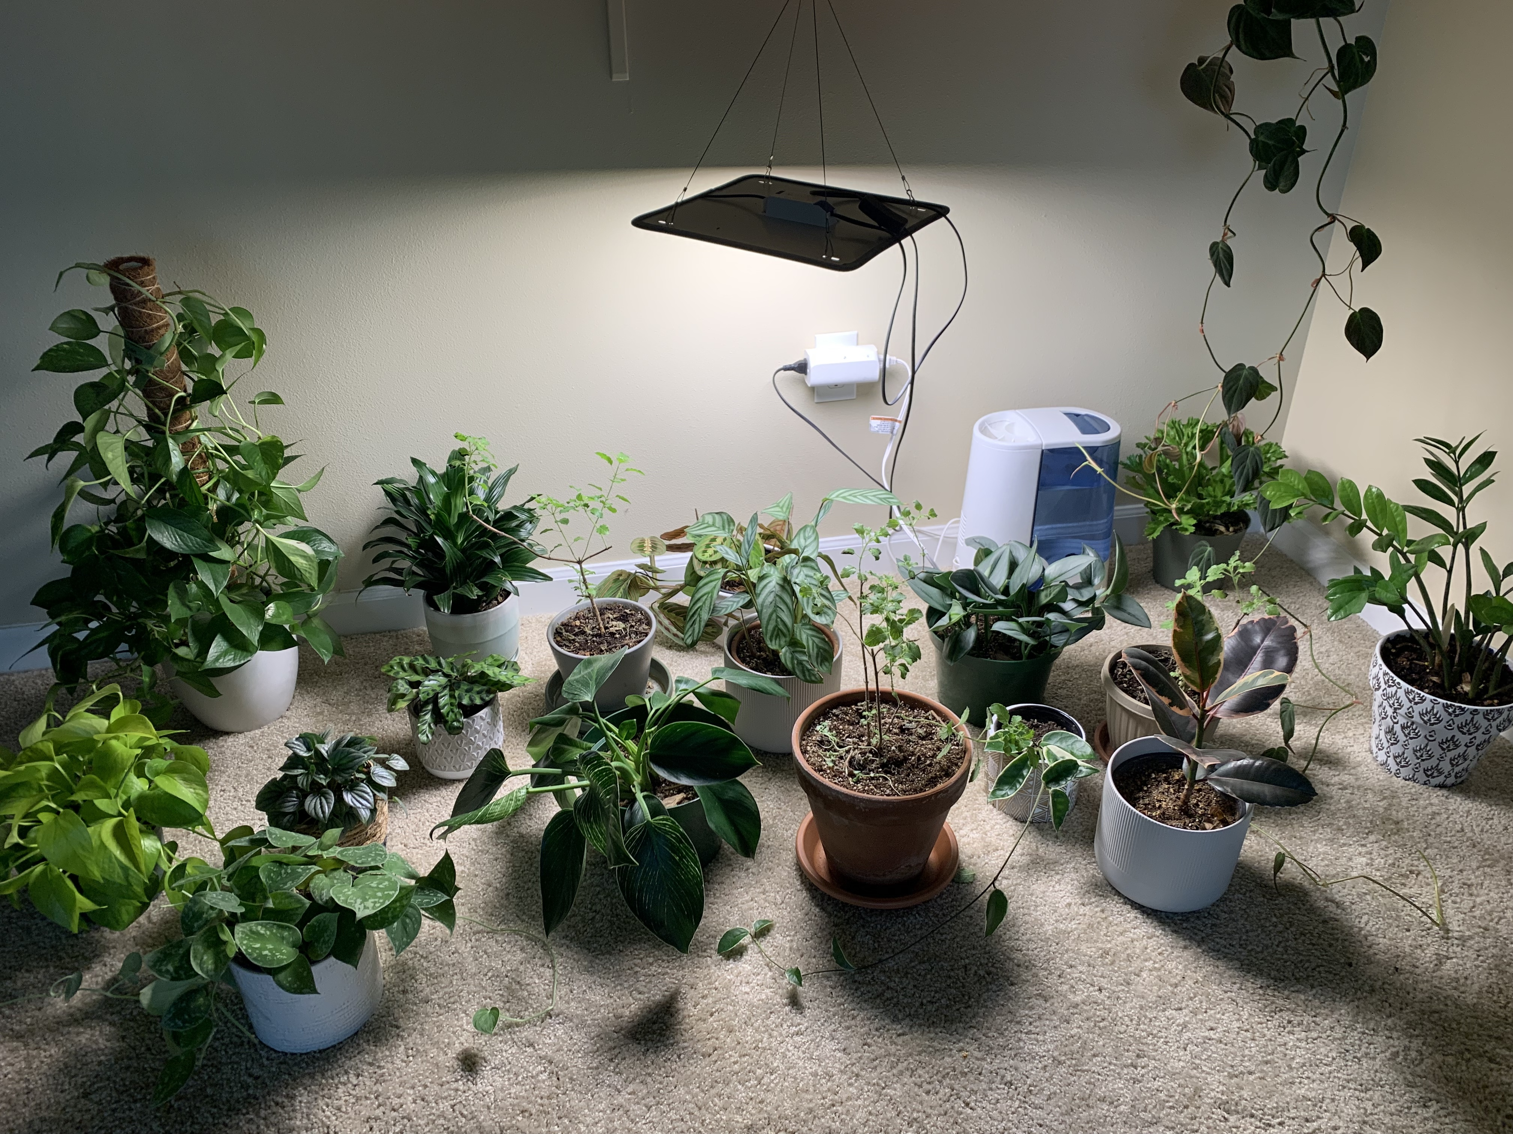
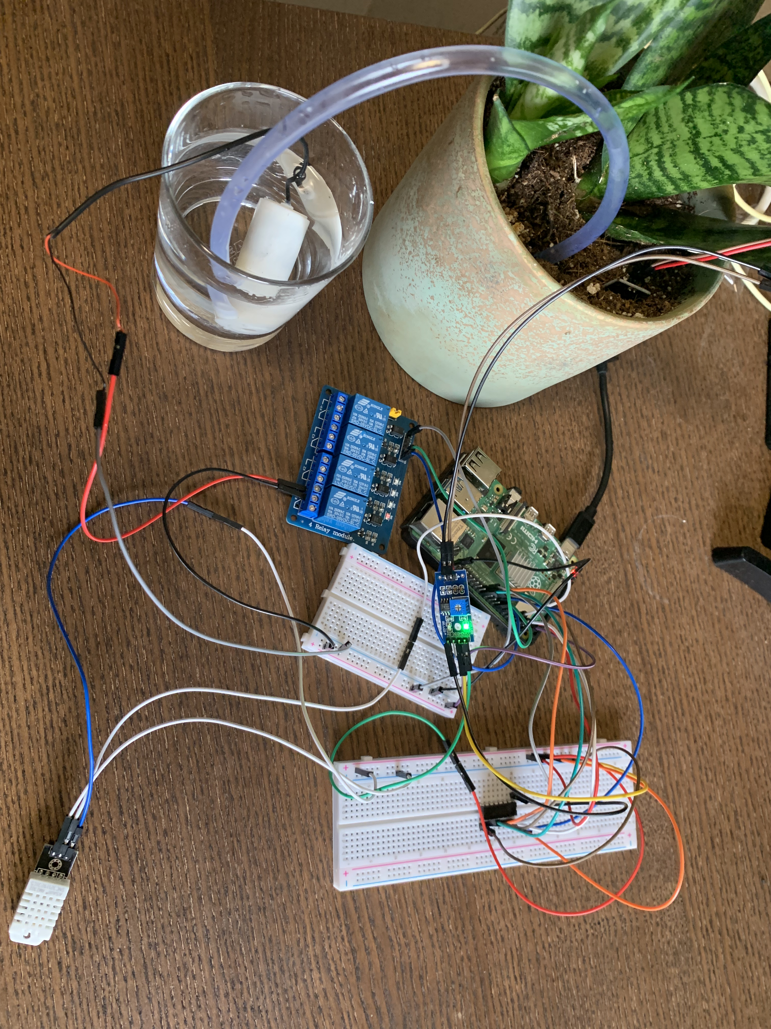

Slide 6
Lessons learned
Never worked on embedded programming before
Reading from sensor and running the pump was really fascinating
Board and GPIO conflict
Happy that my project benefit my plants
Now I will be able to take care of even the most demanding plants

Slide 7
Conclusion and Future work
Reproducing temperature
Reproducing rain patterns
Creating dashboard
Where I can control parameters for each plant
Keep track of plant health.

Slide 8
Thank you!

